Slide 1


Object detection and image classification using a Ornithopter
Project Mentor
Dr. J. Krishnaiah
Done by
M. Durga Sai Anil
118me0015

Slide 2
Problem Statement
Detecting the objects and classifying the objects and recognizing the humans in defense applications using an ornithopter.

Slide 3
Introduction to ornithopter
Ornithopter is one type of flapping wing robot or an Unmanned Air Vehicle which uses its tail to give directions and stabilize itself during the flight.
The oscillatory flapping of the wings helps the ornithopter to generate the high pressure region below its body and gain lift; the wings control the altitude and propulsion of the Ornithopter whereas the tail acts as a steering of the Ornithopter.

Slide 4
Background work Cont.…
Using yolo pretrained model, I created a object detection and image classification. By this model the ornithopter can detect the objects.
Using Cascade classifier I created a facial recognition system. By this model ornithopter can recognize the faces.
Using contour detection I created shape detection model. By this model ornithopter can identify the shapes of a objects.

Slide 5
Background work Cont.…
I created a model for to detect the spoof faces By training a Convolution neural network(CNN). This model can classify between live and spoof images. So by this model ornithopter can understand the face which is live face or fake face.

Slide 6

Work on object detection

Slide 7
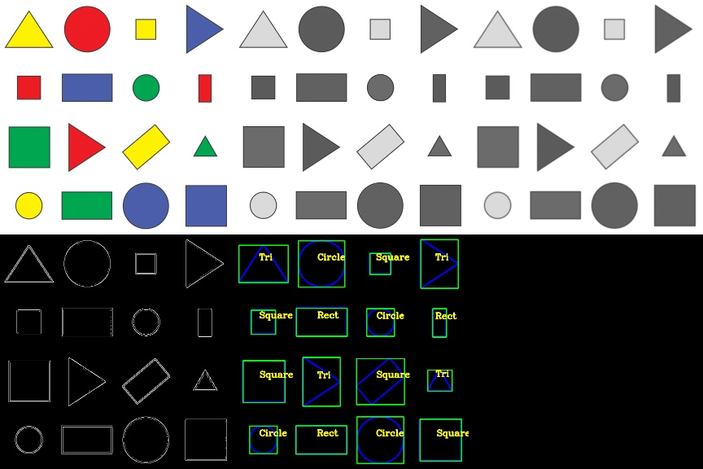
Work on Shape detection

Slide 8
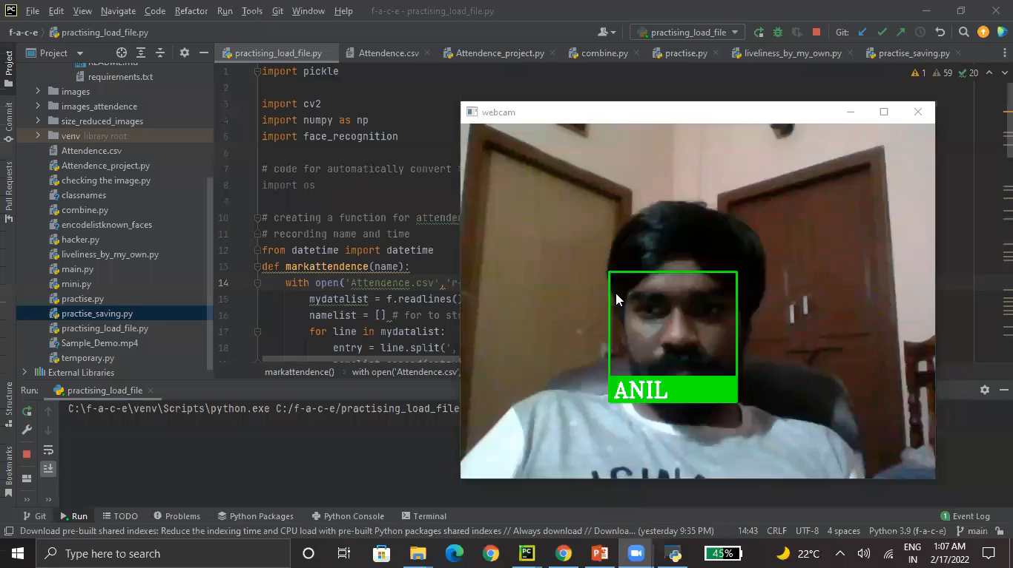
Work on Facial Recognition

Slide 9
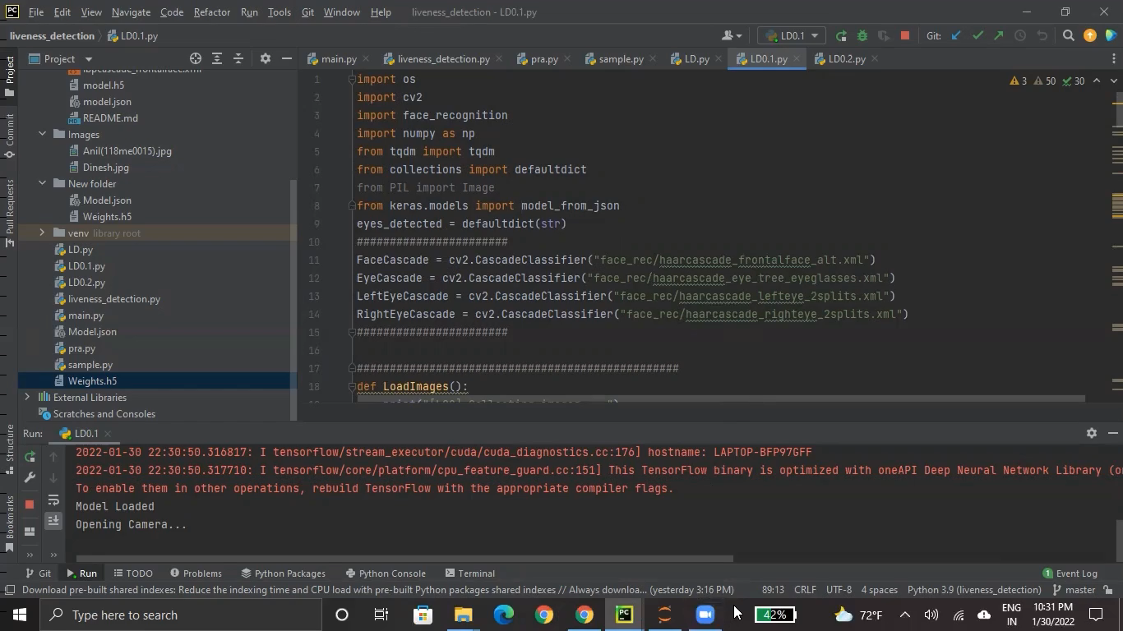
Work on Antispoof Facial Recognition

Slide 10

Ornithopter Building…

Slide 11
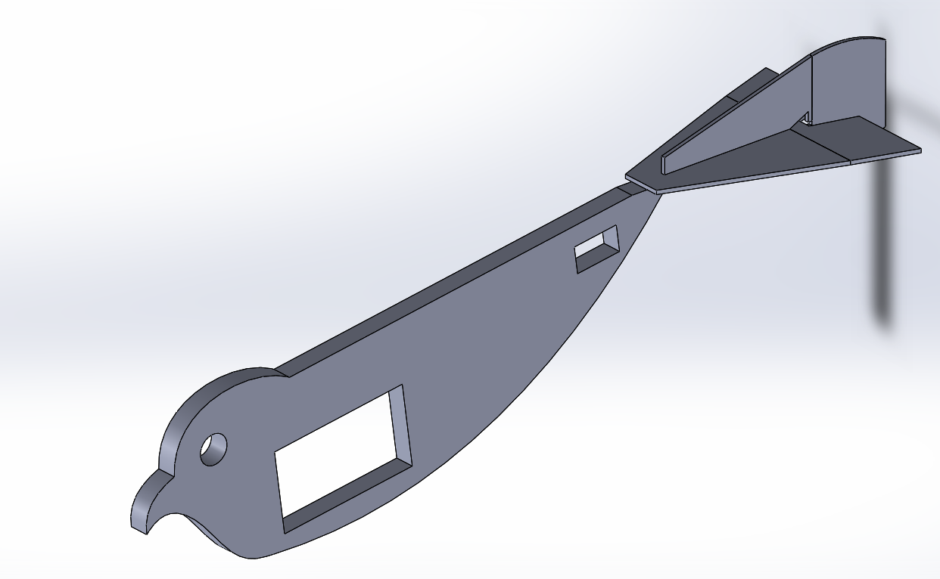
Design-1

Slide 12
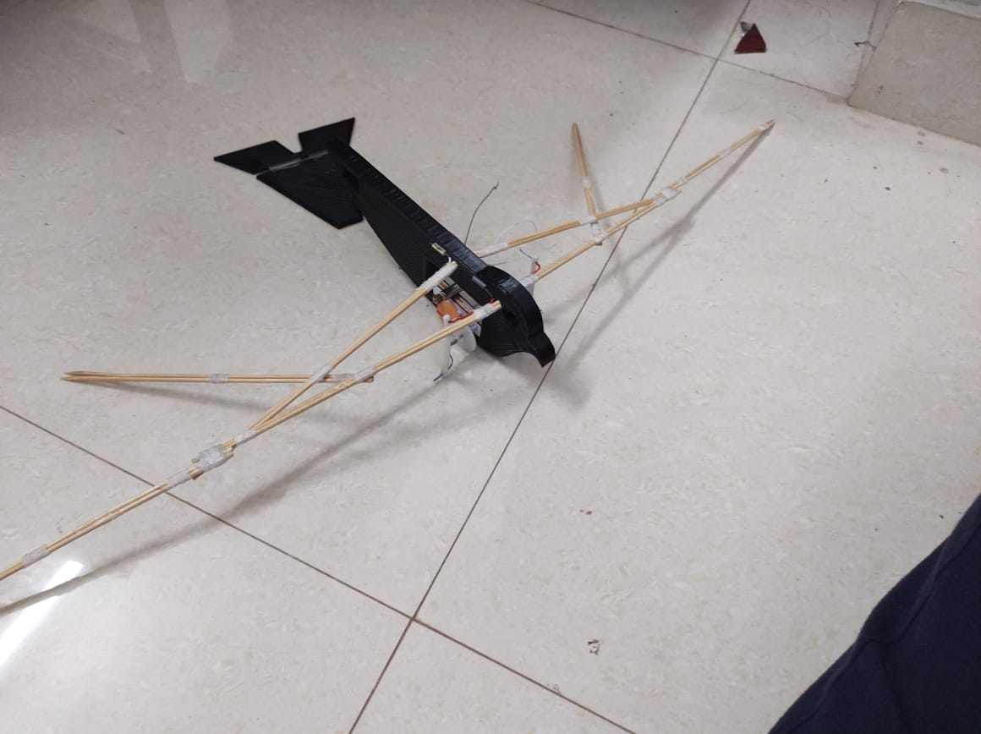
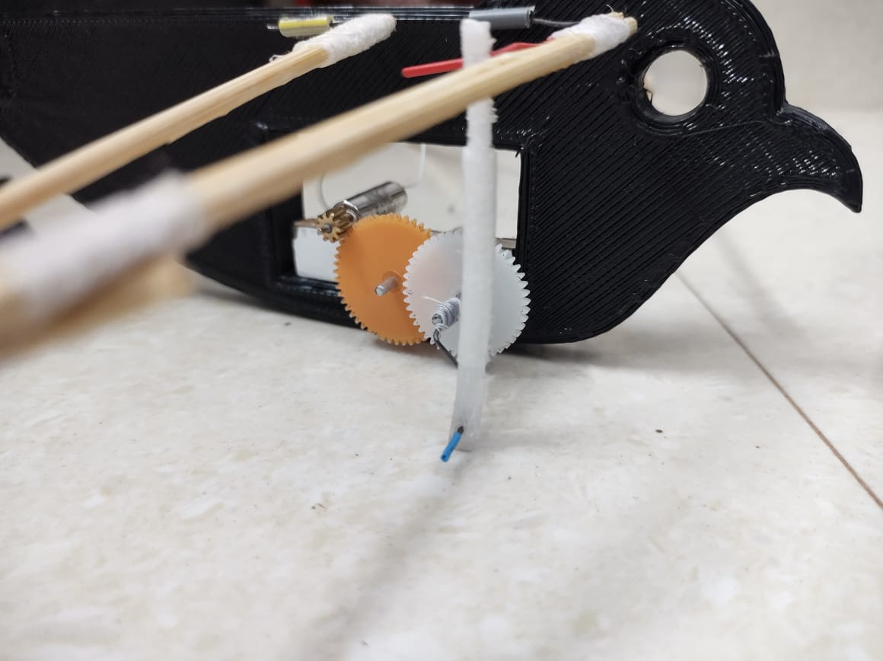
Gear box for design-1

Slide 13
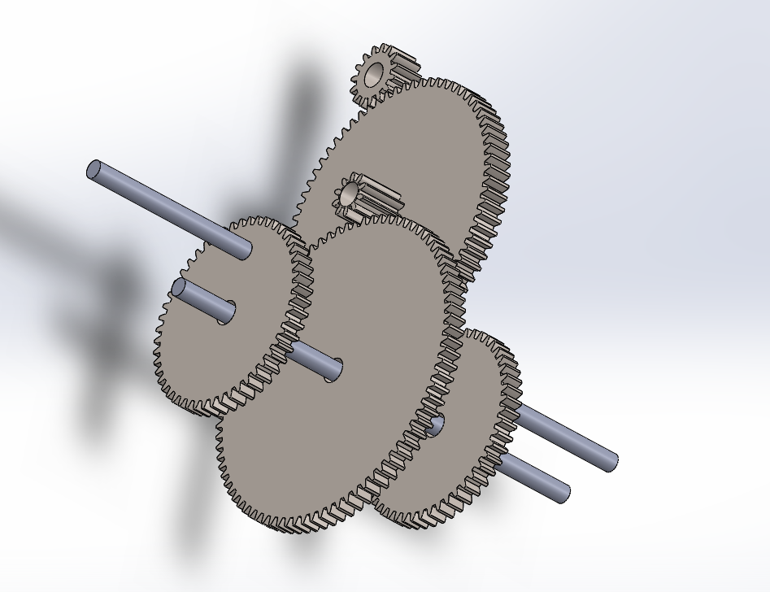
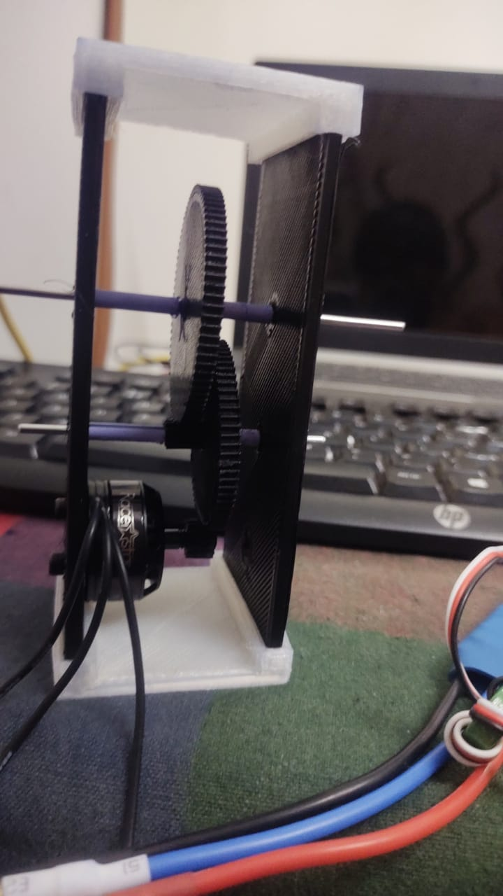
Design-2 Gear Box-1

Slide 14
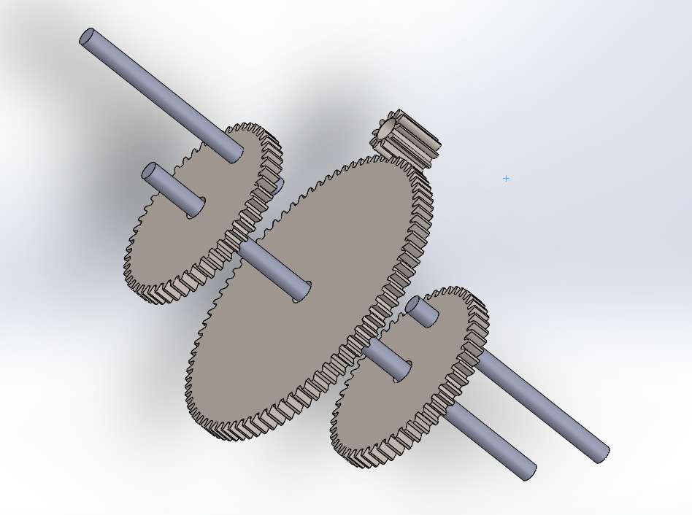
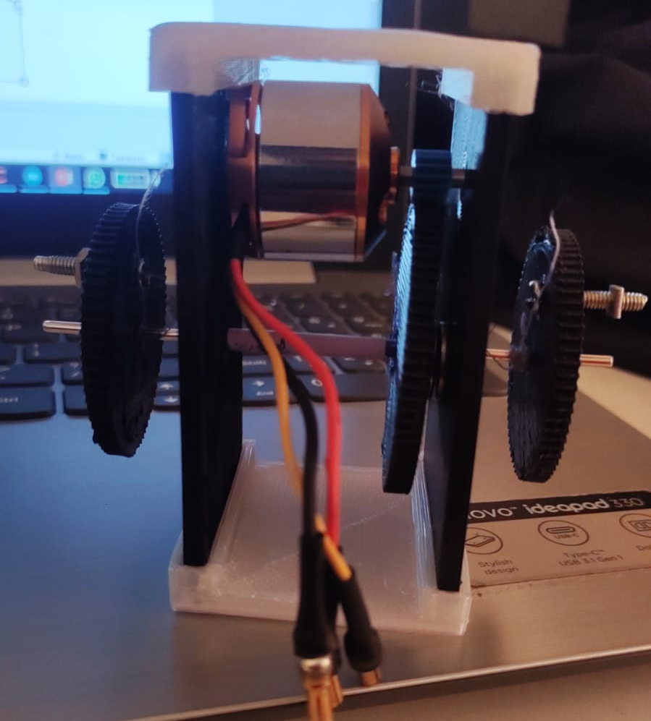
Design-2 Gear Box-1

Slide 15
References
https://www.instructables.com/Opensource-Ornithopter-Prototype-Arduino-Powered-a/
https://www.tensorflow.org/
https://pjreddie.com/darknet/yolo/
https://towardsdatascience.com/facial-recognition-types-of-attacks-and-anti-spoofing-techniques-9d732080f91e
https://towardsdatascience.com/anti-spoofing-techniques-for-face-recognition-solutions-4257c5b1dfc9
https://pyimagesearch.com/2019/03/11/liveness-detection-with-opencv/

Slide 16
References
http://ucu.edu.ua.s3.amazonaws.com/wp-content/uploads/sites/8/2019/12/Arsen-Senkivskyy.pdf
Name of the paper: Anti-spoofing system for facial recognition, Author : Arsen Senkivskyy , organization: Ukrainian Catholic University

Slide 17
Thank You
M. Durga Sai Anil
118me0015

